Slide 1
Analogies
Relationships Between Two Things That Are Different

Slide 2
What Are They?
Two sets of words that you read as if they are a sentence
The relationship between the parts is alike
Improvement for a learner’s comprehension & long-term memory
Useful skill to identify relationships
Connections to concrete from abstract
Critical thinking
Why Solve Analogies?

Slide 3
Word Analogies
Use analogies to develop logic.
Analyze two words and identify the relationship between them.
Find another pair of words that has the same relationship.

Slide 4
Two-Step Process
First, figure out the relationship in a pair of words:
LEAF: TREE
Next, look for a similar relationship in a second pair of words:
PAGE: BOOK

Slide 5
Analogy construction
FIND : LOCATE :: lose : misplace
Colon stands for the phrase
“is related to”
FIND [is related to] LOCATE
LOSE [is related to] MISPLACE
Double colon (::) stands for
“in the same way that”
FIND is the synonym of LOCATE as lose is the synonym to misplace.

Slide 6
COMMON TYPES OF ANALOGIES
Analogy | Examples
Word : Synonym (syn-o-nym) | Plain : Simple
Word : Antonym (ant-o-nym) | Hasten : Delay
Part : Whole | Lens : Camera
Cause : Effect | Burn : Pain
Worker : Tool | Secretary : Computer
Worker : Product | Cobbler : Shoes
Item : Purpose | Pencil : Write
Item : Category | Chipmunk : Rodent

Slide 7
Types of Analogies
What’s the relationship?
DRY : ARID :: lost : mislaid
Both words have similar meanings so this relationship is a synonym

Slide 8
Types of Analogies
What’s the relationship?
KIND : CRUEL :: happy : sad
Both words have opposite meanings, so their relationship is an antonym.

Slide 9
Types of Analogies
What’s the relationship?
CHAPTER : BOOK :: fender : automobile
A chapter is a part of a book just as a fender is a part of an automobile.
Part and Whole
What happens if you switch book and chapter in this analogy?
BOOK : CHAPTER :: fender : automobile
Invalid analogy

Slide 10
Direction Counts
CHAPTER : BOOK :: fender : automobile
If you start solving the analogy with the first word, you must use the first word I the second part of the analogy to solve that part of it.
DAISY: FLOWER :: (A) rye:grain (B)fish:trout (C) violet: rose (D) yellow: petal (E) garden: soil

Slide 11
Direction Counts
CHAPTER : BOOK :: fender : automobile
If you start solving the analogy with the first word, you must use the first word I the second part of the analogy to solve that part of it.
DAISY: FLOWER :: (A) rye:grain (B)fish:trout (C) violet: rose (D) yellow: petal (E) garden: soil

Slide 12
Direction Counts
CHAPTER : BOOK :: fender : automobile
If you start solving the analogy with the first word, you must use the first word I the second part of the analogy to solve that part of it.
DAISY: FLOWER :: (A) rye:grain (B)fish:trout (C) violet: rose (D) yellow: petal (E) garden: soil

Slide 13
Types of Analogies
What’s the relationship?
MIRROR : SMOOTH :: sandpaper : rough
Mirrors are characteristically smooth just as sandpaper is characteristically rough.
Characteristic/Quality

Slide 14
Types of Analogies
What’s the relationship?
POLKA : DANCE :: frog : amphibian BIRD : CARDINAL :: house : igloo
A polka may be classified as a dance; a cardinal is classified as a bird.
Classification

Slide 15
Types of Analogies
What’s the relationship?
GIFT : JOY :: rain : flood TEARS : SADNESS :: smiles : joy
A gift can cause joy; tears are an effect of sadness.
Cause and Effect

Slide 16
Types of Analogies
What’s the relationship?
KNIFE : CUT :: shovel : dig
The function of a knife is to cut.
Function

Slide 17
Types of Analogies
What’s the relationship?
FISH : SEA :: moose : forest
A fish can be found in the sea, just as a moose can be found in a forest.
Location

Slide 18
Types of Analogies
What’s the relationship?
CHUCKLE : LAUGH :: whimper : cry
These words differ in degree. One is more intense than the other.
Degree

Slide 19
Types of Analogies
What’s the relationship?
CASHIER : CASH :: plumber : pipe
A cashier works with cash, just as a plumber works with pipes.
Performer and a related object

Slide 20
Types of Analogies
What’s the relationship?
AUTHOR : WRITE :: chef : cook
You expect an author to write, just as you expect a chef to cook.
Performer and a related action

Slide 21
Types of Analogies
What’s the relationship?
BOIL : EGG :: throw : ball
You boil an egg, just as you throw a ball. (In these items, the object always receives the action.)
Action and a related object

Slide 22
RECOGNIZING ANALOGIES
Click to Begin
Dentist : Drill ::
(A) Calendar : Date (B) Sculptor : Chisel
(C) Lumberjack : Forest (D) Eyeglasses : Sight (E) Hammer: Carpenter
2. Horse : Mammal ::
(A) Insect : Beetle (B) Beaver : Fish
(C) Snake : Reptile (D) Trout : Halibut (E) Animal : Tiger
3. Hasten : Hurry ::
(A) Laugh : Talk (B) Trust : Doubt
(C) Stammer : Whisper (D) Attempt : Try (E) Explain : Understand
4. Ranch : Cattle ::
(A) People : City (B) Chickens : Coop
(C) Garden : Vegetables (D) Automobile : Garage (E) Clowns : Circus

Slide 23
RECOGNIZING ANALOGIES
Click to Continue
5. Calm : Restless ::
(A) Vague : Indefinite (B) Tiny : Small
(C) Colorless : Transparent (D) Loud : Noisy (E) Gloomy : Brilliant
6. Daisy : Flower ::
(A) Rye : Grain (B) Fish : Trout
(C) Violet : Rose (D) Yellow : Petal (E) Garden : Soil
7. Foundation : Base ::
(A) Handle : Door (B) Shoes : Belt
(C) Ruler : Inch (D) Guest : Visitor (E) Top : Bottom
8. Director : Movie ::
(A) Doctor : Patient (B) Cook : Diet
(C) Conductor : Symphony (D) Teacher : School (E) Building : Architect

Slide 24
Recognizing Analogies
9. ANECDOTE: TELL::
(A) lecture: sing (B) letter: write
(C) television: delay (D) weed: garden
CONSISE: WORDY::
(A) apologize: explain (B) exist: live
(C) offer: suggest (D) arrive: leave
11. MENACE: RECKLESS DRIVER::
(A) danger: loaded gun (B) food: plastic bag
(C) medicine: cold (D) rescue: shark attack

Slide 25
Recognizing Analogies
DIALOG: CONVERSATION::
(A) telephone: email (B) radio: book
(C) lecture: speech (D) letter: write
13. ILLUMINATE: LIGHTBULB::
(A) heat: furnace (B) cool: mixer
(C) odd: typical (D) water: oil
SCAPEGOAT: BLAME
(A) Movie star: fame (B) bird: robin
(C) aunt: uncle (D) soldier: sailor
15. ILLUSION: MAGICIAN::
(A) textbook: student (B) dinner: chef
(C) candidate: election (D) movie: audience

Slide 26
Analogies in Social Studies
Thomas Jefferson: Declaration of Independence::
James Madison: Constitution
Thomas Jefferson was an author of the Declaration of Independence, just as James Madison was an author of the Constitution

Slide 27
Analogies in Science
tadpole: frog:: caterpillar: butterfly (moth)
The relationship sentence would be
A tadpole develops into a frog, just as a caterpillar develops into a butterfly (moth)

Slide 28
"MTV is to music as KFC is to chicken." (Lewis Black)

Slide 29
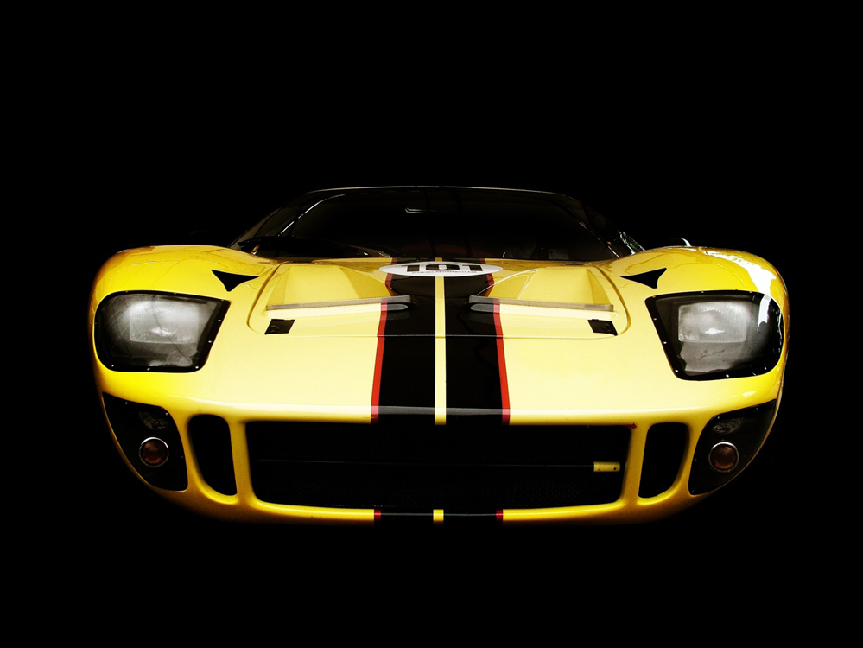
"Harrison Ford is like one of those sports cars that advertise acceleration from 0 to 60 m.p.h. in three or four seconds. He can go from slightly broody inaction to ferocious reaction in approximately the same time span. And he handles the tight turns and corkscrew twists of a suspense story without losing his balance or leaving skid marks on the film. But maybe the best and most interesting thing about him is that he doesn't look particularly sleek, quick, or powerful; until something or somebody causes him to gun his engine, he projects the seemly aura of the family sedan." (Richard Schickel, Time magazine review of Patriot Games)

Slide 30
"Memory is to love what the saucer is to the cup." (Elizabeth Bowen, The House in Paris, 1949)

Slide 31
Analogies
http://www.sadlier-oxford.com/phonics/analogies/analogiesx.htm
http://www.quia.com/cb/7146.html
http://a4esl.org/q/f/z/zz67fck.htm

Slide 32
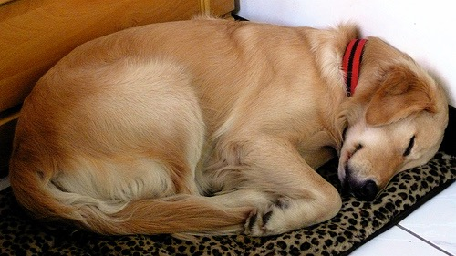
That’s All!

